Slide 1


MTPM-760 DevOps Essentials
Instructor: Josh Phillips Semester: Spring 2021

Slide 2
A Word of Warning
“You can’t buy a DevOps but you can sure sell a DevOps” – Overheard
Notes:
As someone who has worked in software consulting for quite some time and had many DevOps titles including Cloud Engineer, DevOps Automation Engineer, Site Reliability Engineer, DevOps Lead, Cloud Lead, and several others, let me be the first to express a healthy skepticism for DevOps as a prescriptive term. DevOps at it’s core is just a series of technological, architectural, procedural, and cultural processes that have been found to improve software delivery performance. Throughout this course we will be investigating many of them. At times some of the reading may feel theoretical and at times some of the organizational change work may seem idealized. We will try and strike a healthy balance between exploring and pulling apart buzz words, concepts that seem like wand waving, and abstractions and balance them with shared real world experience and values. The purpose of this course isn’t to sell anyone a DevOps, but to help you navigate the terms, concepts, and technologies involved in DevOps that you will experience throughout your career.

Slide 3
About Me
Josh Phillips – Sr. DevOps and Cloud Engineering Lead
15 Years in IT
Previous Roles: Web developer, Bioinformatician, Big Data Consultant, Project Manager, Site Reliability Engineer
Adjunct Professor by Night (This is my first semester)
I love solving software delivery issues and creating software to improve delivery of cloud native technology
I love videogames, movies, and music
I have been a student, staff, and now faculty member here at Georgetown. (They keep pulling me back!)
Note: The cutie on the right is my lab / whippet mix Chepito (yes he is dressed like a pirate)

Slide 4
Tell Me About You
Take some time and answer the following prompts:
Name that you’d like to be called
Current Career
Desired Career
A fun fact
Level of Hands on Technical Knowledge: 1 use technology but not sure how any of it works 1- Super Hacker
What you’re hoping to get out of this class
Your current definition of DevOps (It’s ok if you don’t have one, just try your best)

Slide 5
The Textbook Definition
“….”

Slide 6
Ok technically the book says…
DevOps is a convergence of many different movements:
The Lean Movement
The Agile Movement
The Velocity Conference Movement
The Agile Infrastructure Movement
The Continuous Delivery Movement
The Toyota Kata Movement
The Lean Startup Movement
The Lean UX Movement
The Rugged Computing Movement

Slide 7
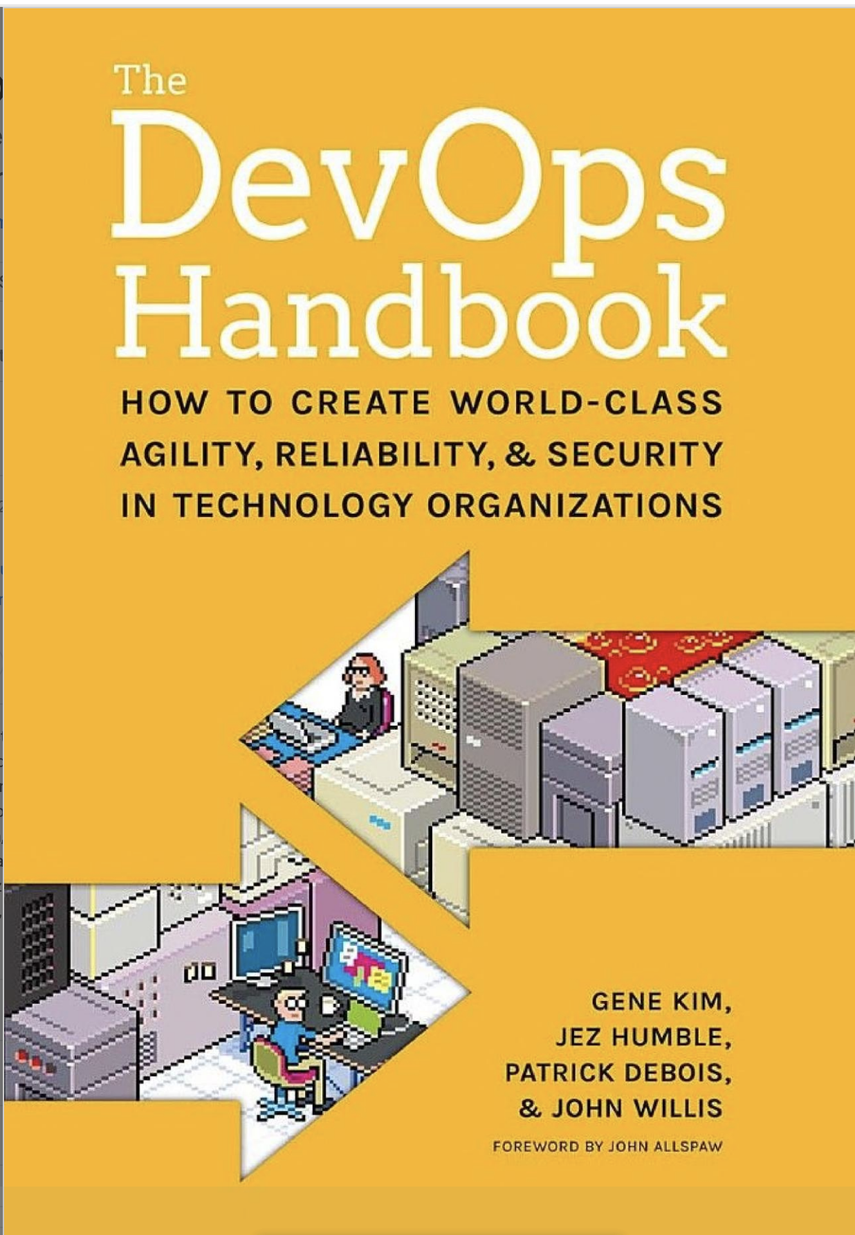
The Textbooks

Slide 8
My Definition of DevOps
DevOps is a series of procedural, architectural, and cultural norms aimed at decreasing software delivery time while increasing software quality.
You can sell DevOps but you can’t buy DevOps
DevOps is a term in flux, it has changed over time to take on a wide variety of meanings and can mean very different things to different people

Slide 9
DevOps As a Term Can Change
For example:
To a software engineer DevOps may mean their software testing and deployment automation tooling like Jenkins, Git, Docker, Kubernetes, New Relic, and AWS
To a project manager: DevOps may mean cultural practices like creating a lightweight change management process or moving security to an earlier time in the software delivery lifecycle
To a DevOps engineer DevOps may mean anything from:
Creating and configuring servers
Helping create local development setups
Advising organizations on automation tooling

Slide 10
Working Together
“Imagine a world where product owners, Development, QA, IT Operations, and Infosec work together..” – The DevOps Handbook – xxi

Slide 11
Breaking down silos between different teams involved in software delivery. These teams include, but are not limited too: developers, data science, QA, It operations, infosec, product design. Really just any team that is involved in delivering software changes.

Slide 12
Reality
?

Slide 13
Reality
Teamwork is hard:
Many organizations are siloed, often operations, security, and development teams are all incentivized in different ways and this can lead to conflict and delayed time to deployment.
Agile software development has created a higher output of smaller incremental pieces of work but deploying this work into production and across teams is still very tricky and can be very time consuming

Slide 14
“It’s not my code it’s your machines”
“It’s not my machines it’s your code”
Dev
Ops

Slide 15

Dev and Ops Stereotypes
Source: John Allspaw (Flickr/Yahoo!) and Paul Hammond (Flickr) "10+ Deploys Per Day: Dev and Ops Cooperation at Flickr" - https://www.youtube.com/watch?v=LdOe18KhtT4

Slide 16
Ops Stereotypes:

Slide 17
Ops Stereotypes:
Ops says no all the time

Slide 18
Ops Stereotypes:
Ops says no all the time
This doesn’t allow for great cooperation or communication, and further compounds the problem.

Slide 19
DevOps: A Practical Definition
DevOps: How to deploy to production frequently without breaking everything

Slide 20
Modern DevOps
Question 1:
What are the characteristics of a high performing software organization?

Slide 21
Modern DevOps
Question 2:
How can success be reliably measured?

Slide 22
Measuring Software Delivery Performance
Outcome over Output
Example: Problem with measuring lines of code committed?

Slide 23
Measuring Software Delivery Performance
Outcome over Output
Example 1: Problem with measuring lines of code committed?
10 line vs 10,000 line solution
Incentivizing shortest length solution has readability issues
Example 2: Velocity i.e story points

Slide 24
Measuring Software Delivery Performance
Outcome over Output
Example 1: Problem with measuring lines of code committed?
10 line vs 10,000 line solution
Incentivizing shortest length solution has readability issues
Example 2: Velocity i.e story points
Story points are relative and team dependent
This can inhibit collaboration as teams skew numbers

Slide 25
Measuring Software Delivery Performance
Successfully measuring performance:
Focus on global outcomes that don’t pit teams against each other
Don’t lead to busywork in order to skew numbers
Metrics:
Delivery lead time
Deployment frequency
Time to restore service
Change fail rate

Slide 26
Lead Times
“Shorter product delivery lead times are better since they enable faster feedback on what we are building and allow us to course correct more rapidly. Short lead times are also important when there is a defect or outage and we need to deliver a fix rapidly and with high confidence. We measured product delivery lead time as the time it takes to go from code committed to code successfully running in production, and asked survey respondents to choose from one of the following options:
less than one hour
less than one day
between one day and one week
between one week and one month
between one month and six months
more than six months“

Slide 27
Deployment Frequency
“ By “deployment” we mean a software deployment to production or to an app store. A release (the changes that get deployed) will typically consist of multiple version control commits, unless the organization has achieved a single-piece flow where each commit can be released to production (a practice known as continuous deployment). We asked survey respondents how often their organization deploys code for the primary service or application they work on, offering the following options:
on demand (multiple deploys per day)
between once per hour and once per day
between once per day and once per week
between once per week and once per month
between once per month and once every six months
fewer than once every six months”

Slide 28
Time to Restore
They asked participants how long it took them to restore using the same responses as deployment frequency

Slide 29
Change Fail Percentage
They asked participants what % of deployments to production failed and needed remediation.

Slide 30
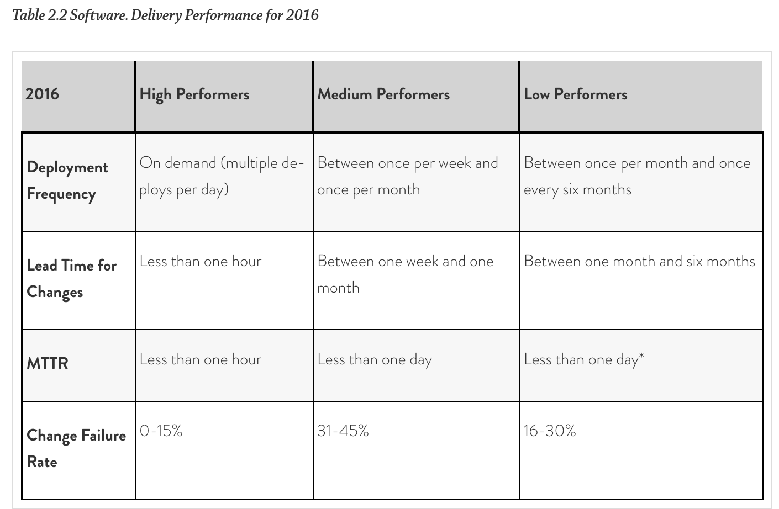
Performance Results for 2016

Slide 31
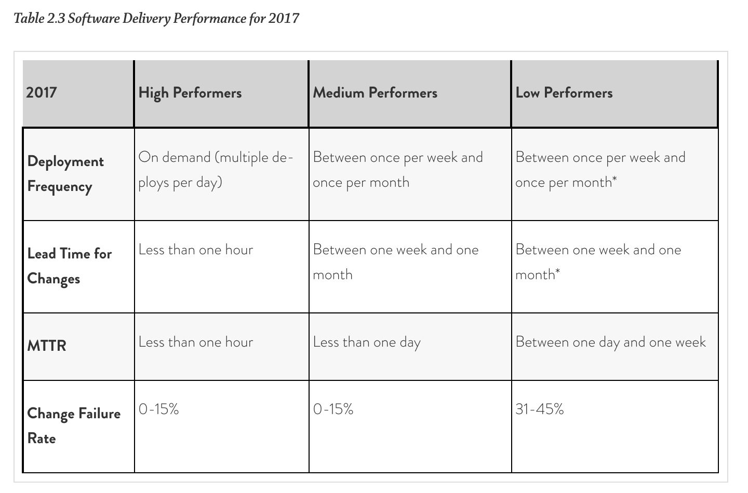
Performance Results for 2017

Slide 32
Results
According to the industry researched published in Jez Humble, Nicole Forsgren, and Gene Kim’s book Accelerate high performing software organizations have 24 capabilities that statistically drive improvement in software delivery performance. These capabilities fall into the following 5 categories
Continuous delivery
Architecture
Product and process
Lean management and monitoring
Cultural

Slide 33
Continuous Delivery: A Brief Introduction
We’ll be talking a lot about continuous delivery throughout the course. I believe very strongly that it’s the single most quantifiable and practical concept in DevOps. Organizational Change Management is hard, and while we discuss in depth ways that organizations can adapt to the increased pressures of decreased time to delivery of new features, the most repeatable and easily implemented process is Continuous Delivery

Slide 34
What is Continuous Delivery?
Software is maintained in a deployable state throughout its lifecycle, and the team prioritizes keeping the software in a deployable state over working on new features
Fast feedback on the quality and 'deployability' of the system is available to all team members and then reports are made that the system isn't deployable, fixes are made quickly
Software can be deployed to production or end users at any time, on demand

Slide 35
How to Practice Continuous Delivery
Use version control for all production artifacts.
Automate your deployment process.
Implement continuous integration.
Use trunk-based development methods
Implement test automation.
Support test data management
Shift left on security.
Implement continuous delivery (CD).

Slide 36
Use version control for all production artifacts.
Version control is the use of a version control system, such as GitHub or Subversion, for all production artifacts, including application code, application configurations, system configurations, and scripts for automating build and configuration of the environment.

Slide 37
Automate your deployment process.
Deployment automation is the degree to which deployments are fully automated and do not require manual intervention.

Slide 38
Implement continuous integration.
Continuous integration (CI) is the first step towards continuous delivery. This is a development practice where code is regularly checked in, and each check-in triggers a set of quick tests to discover serious regressions, which developers fix immediately. The CI process creates canonical builds and packages that are ultimately deployed and released.

Slide 39
Use trunk-based development methods.
Trunk-based development has been shown to be a predictor of high performance in software development and delivery. It is characterized by fewer than three active branches in a code repository; branches and forks having very short lifetimes (e.g., less than a day) before being merged into master; and application teams rarely or never having “code lock” periods when no one can check in code or do pull requests due to merging conflicts, code freezes, or stabilization phases.

Slide 40
Implement test automation.
Test automation is a practice where software tests are run automatically (not manually) continuously throughout the development process. Effective test suites are reliable—that is, tests find real failures and only pass releasable code. Note that developers should be primarily responsible for creation and maintenance of automated test suites.

Slide 41
Support test data management
Test data requires careful maintenance, and test data management is becoming an increasingly important part of automated testing. Effective practices include having adequate data to run your test suite, the ability to acquire necessary data on demand, the ability to condition your test data in your pipeline, and the data not limiting the amount of tests you can run. We do caution, however, that teams should minimize, whenever possible, the amount of test data needed to run automated tests

Slide 42
Shift left on security
Integrating security into the design and testing phases of the software development process is key to driving IT performance. This includes conducting security reviews of applications, including the infosec team in the design and demo process for applications, using preapproved security libraries and packages, and testing security features as a part of the automated testing suite.

Slide 43
Implement continuous delivery (CD).
CD is a development practice where software is in a deployable state throughout its lifecycle, and the team prioritizes keeping the software in a deployable state over working on new features. Fast feedback on the quality and deployability of the system is available to all team members, and when they get reports that the system isn’t deployable, fixes are made quickly. Finally, the system can be deployed to production or end users at any time, on demand

